Slide 1

Introduction to Kubernetes
Ranjitha K (PhD),
P S Prashanth (PhD),
Dept. of CSE,
IIT Hyderabad
https://www.netxiith.in/
Credits : Udemy Kubernetes for Absolute Beginners – Hands-on

Slide 2
Monolithic to Microservices
Presentation Layer
Service A
mongoDB
web
Service Layer
API
Service B
mySQL
Persistence Layer
mobile
Service C
Service D
DB
Monolithic Architecture
Microservices Architecture
Notes:
Recent years have seen a great shift in applications moving from monolithic architecture to micro service based architecture
Cloud based applications have one public facing service or the front end microservice that handles the user requests.
Front end service handles the user request by internally communicating with several other microservices using remote procedure calls.

Slide 3
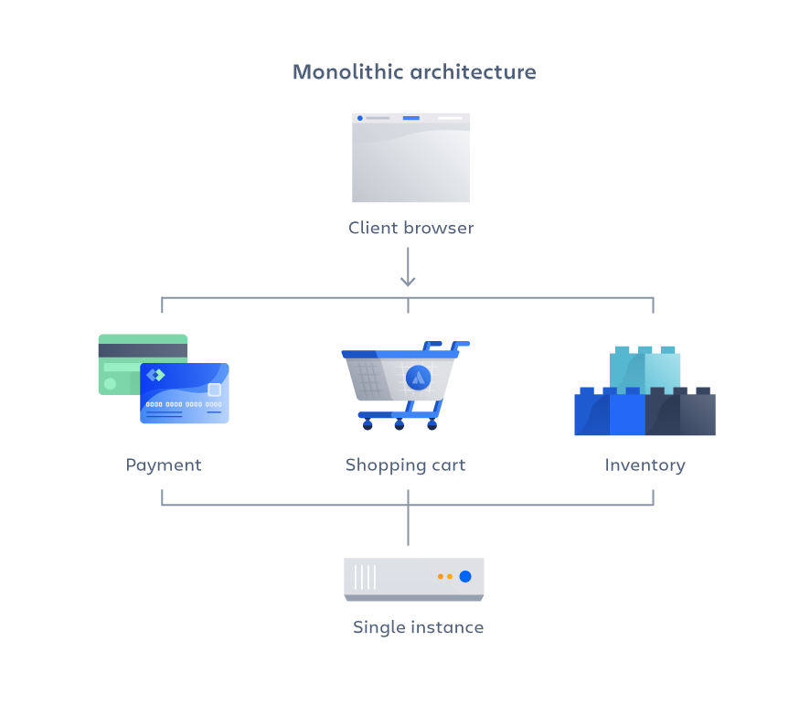
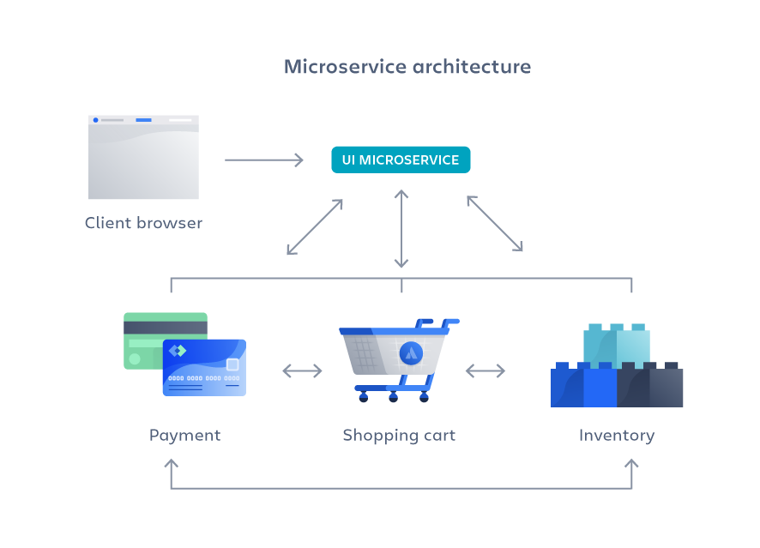
Monolithic Vs. Microservices architecture
Adv.: easy to deploy, performance, easy to debug
Disadv.: as code and features grow:
compile and test every time
complicates dev.
won’t scale well
fault at one comp. breaks whole app
Adv.: Agility, scaling, testable, tech. flexibility
Disadv.: complex, expensive, debugging, lack of ownership
Netflix: first high-profile company, 1000’s of microservices, 1000’s of code changes per day
https://www.atlassian.com/microservices/microservices-architecture/microservices-vs-monolith

Slide 4
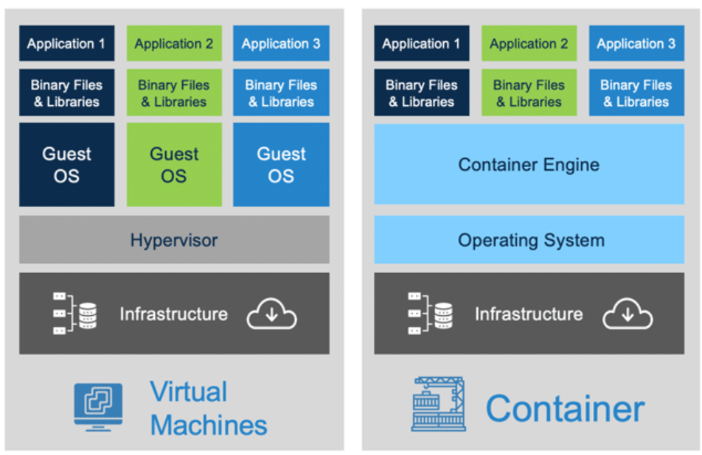
Virtual machines Vs. Containers
VMs:
Virtualization at the HW level
Guest OS + App libraries and binaries
Heavyweight, but flexible
Portability is too slow to adapt to workloads
Full isolation, hence more secure
Containers:
OS-level virtualization: share the host OS
Only app logic, libraries, and binaries
Lightweight: starts in millisecs
Process-level isolation, hence less secure

Slide 5
Why containers?
Lightweight
Comprises application, libraries and dependencies.
Gets rid of compatibility issues.
Start quickly
Need less hardware resource
Run tens and hundreds of containers side-by-side.

Slide 6
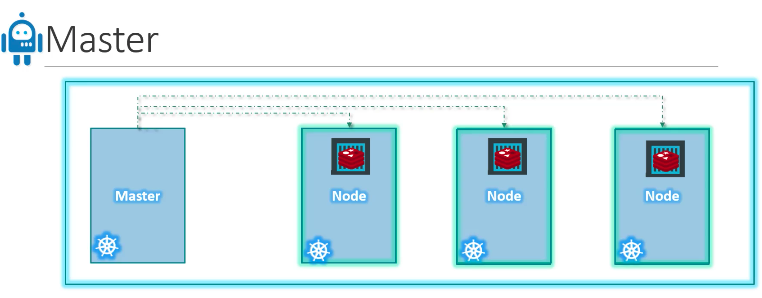
Container orchestration
Managing containers: handle load, load balance, create instances, etc
Orchestrators: Docker swarm, kubernetes (Google), Mesos (Apache)
Kubernetes: Can manage 1000’s of containers
Cluster has master node and worker node

Slide 7
Major components in the master node
Kube-API server
Responsible to communicate with the worker nodes
etcd
Data structure storing information about the cluster
Controller
Decision maker in the cluster
Scheduler
Schedules multiple instances of service in worker nodes
Master node

Slide 8
Major components in the worker node
Kubelet
Communicate with the API server
Container runtime interface
Execute and maintain the containers in the pods
Worker node

Slide 9
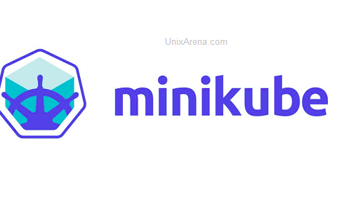
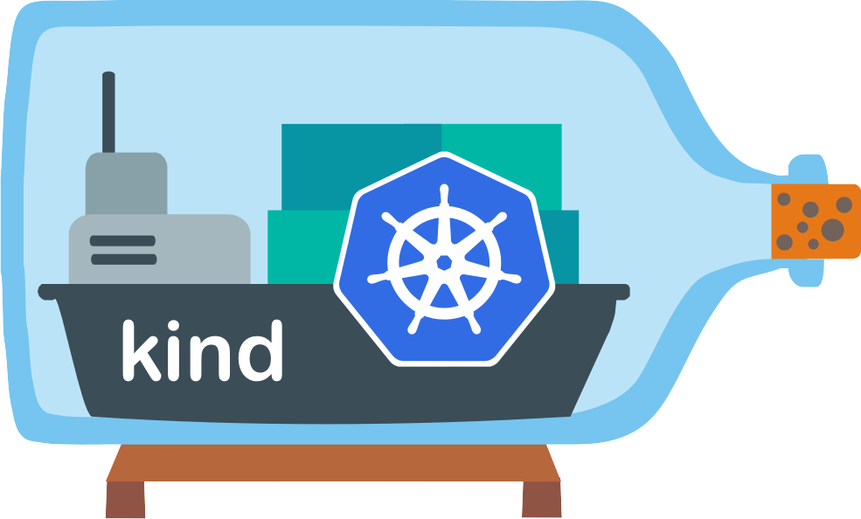
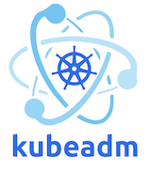

Common tools for creating & managing K8s cluster
Minikube
Kind
Kubeadm
Kops
For desktop and testing purposes
For cluster level and production purpose

Slide 10
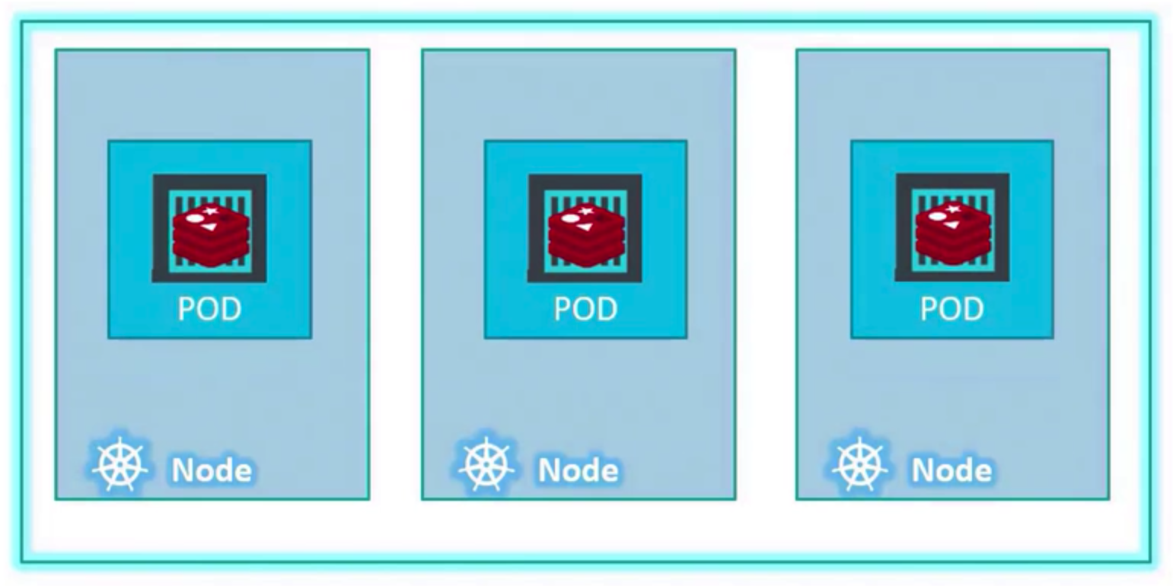
POD: A simplest object in Kubernetes
A pod can have multiple containers of diff. kind
E.g., App container and helper container

Slide 11
Kind hands-on
Create cluster
$ cd HOME
$ sudo kind create cluster --config demo/kind-config.yaml
Setting the necessary config files
$ mkdir .kube
$ sudo kind get kubeconfig > $HOME/.kube/config

Slide 12
Pod Demo
Run a pod
$ kubectl run nginx --image=nginx
$ kubectl get pods
$ kubectl describe pod nginx
$ kubectl get pods –o wide
Notes:
How to run a pod in a cluster

Slide 13
YAML in Kubernetes
apiVersion: ​
​
kind:​
​
​metadata:​
​
​
spec:
Kubernetes API version
Type of object
Data about the object
Specification of the object

Slide 14
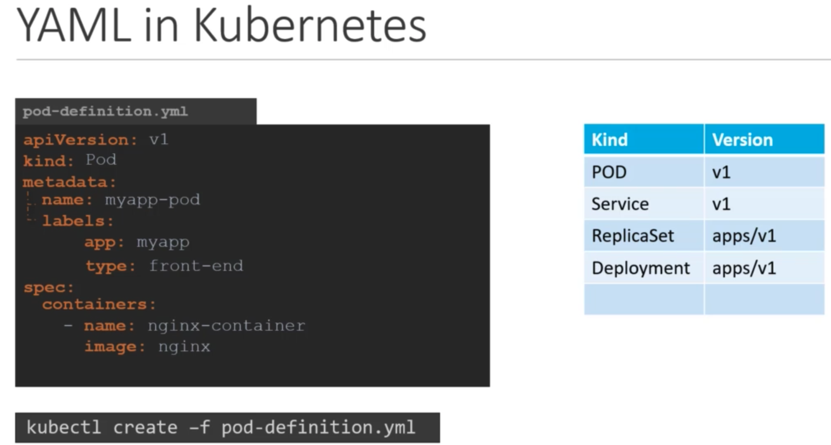
Dictionary
Labels are used
for searching pod kind in a cluster
List of containers in a pod
kubectl get pods
kubectl describe pod myapp-pod

Slide 15
YAML Demo
Create a pod using yaml file
$kubectl create –f pod.yaml
$ kubectl get pods
$ kubectl get pods --o wide
$ kubectl describe pod nginx1

Slide 16
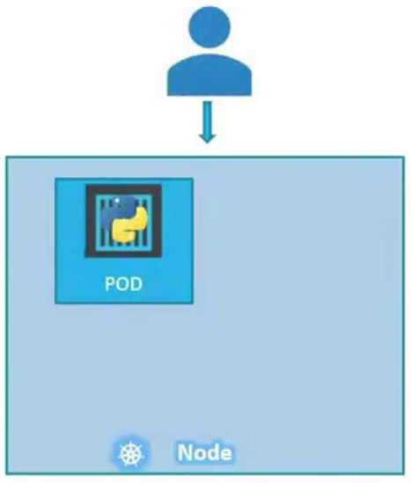
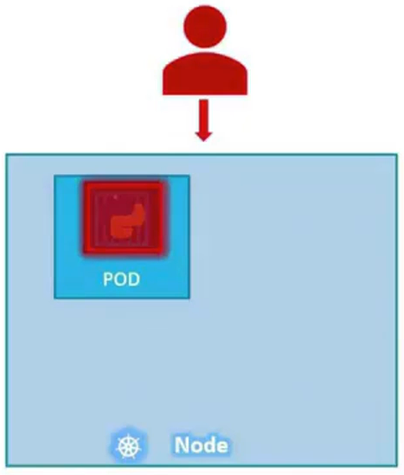
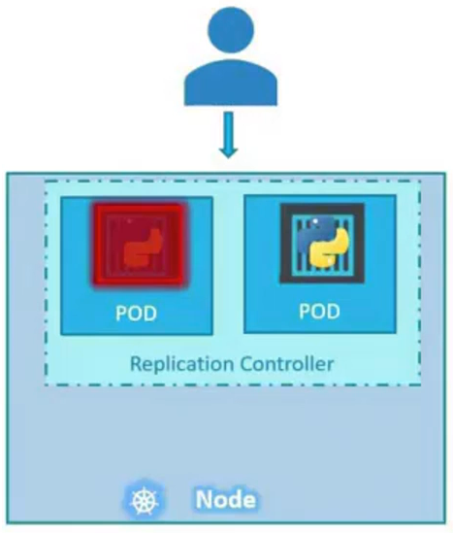
ReplicaSet Controller
Achieve high availability by ensuring specified number of pods are running

Slide 17
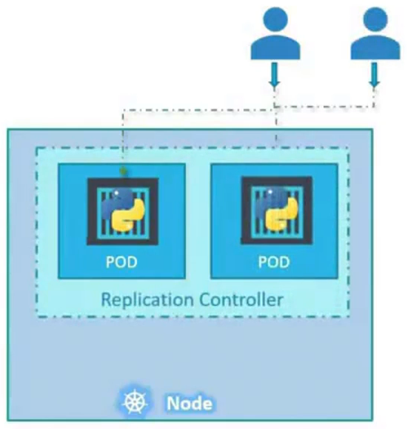
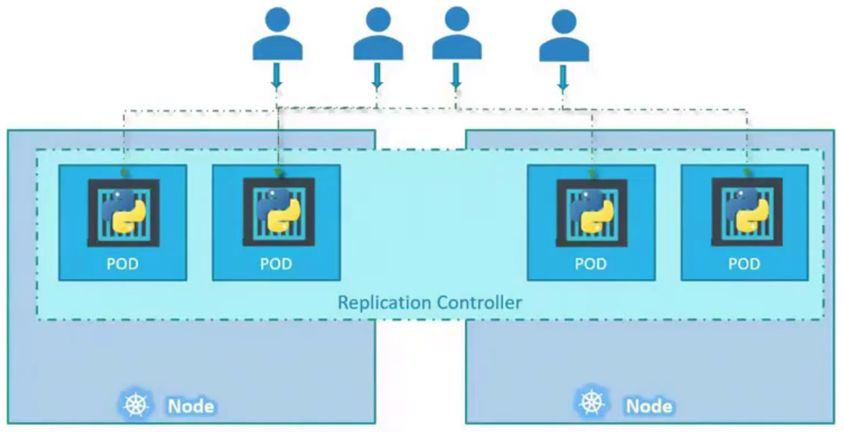
Load Balancing and Scaling

Slide 18
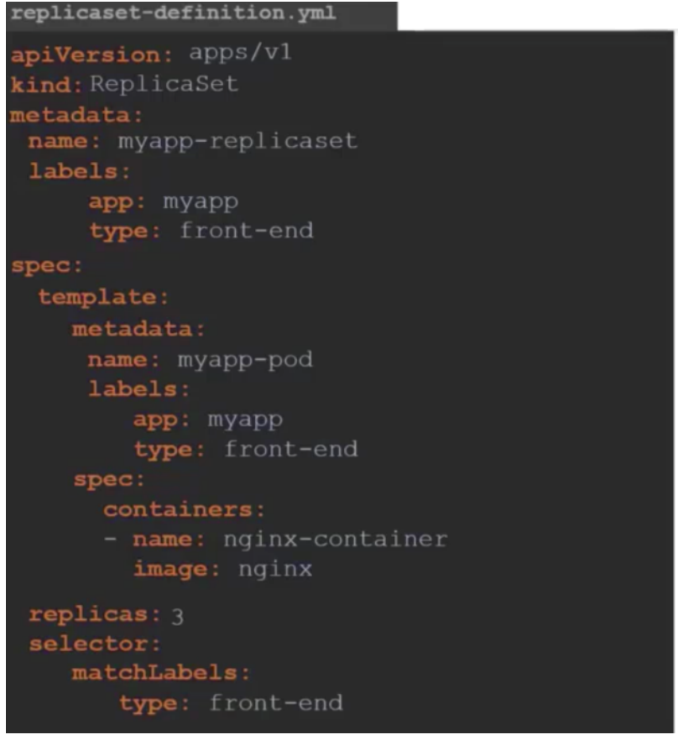
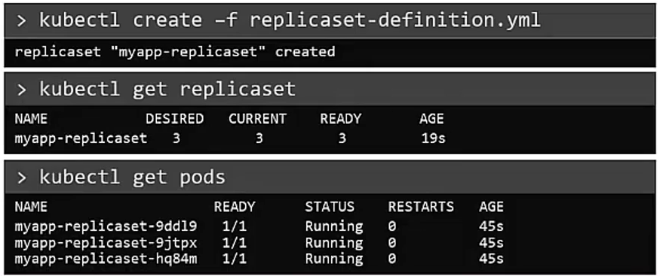
Replicaset YAML

Slide 19
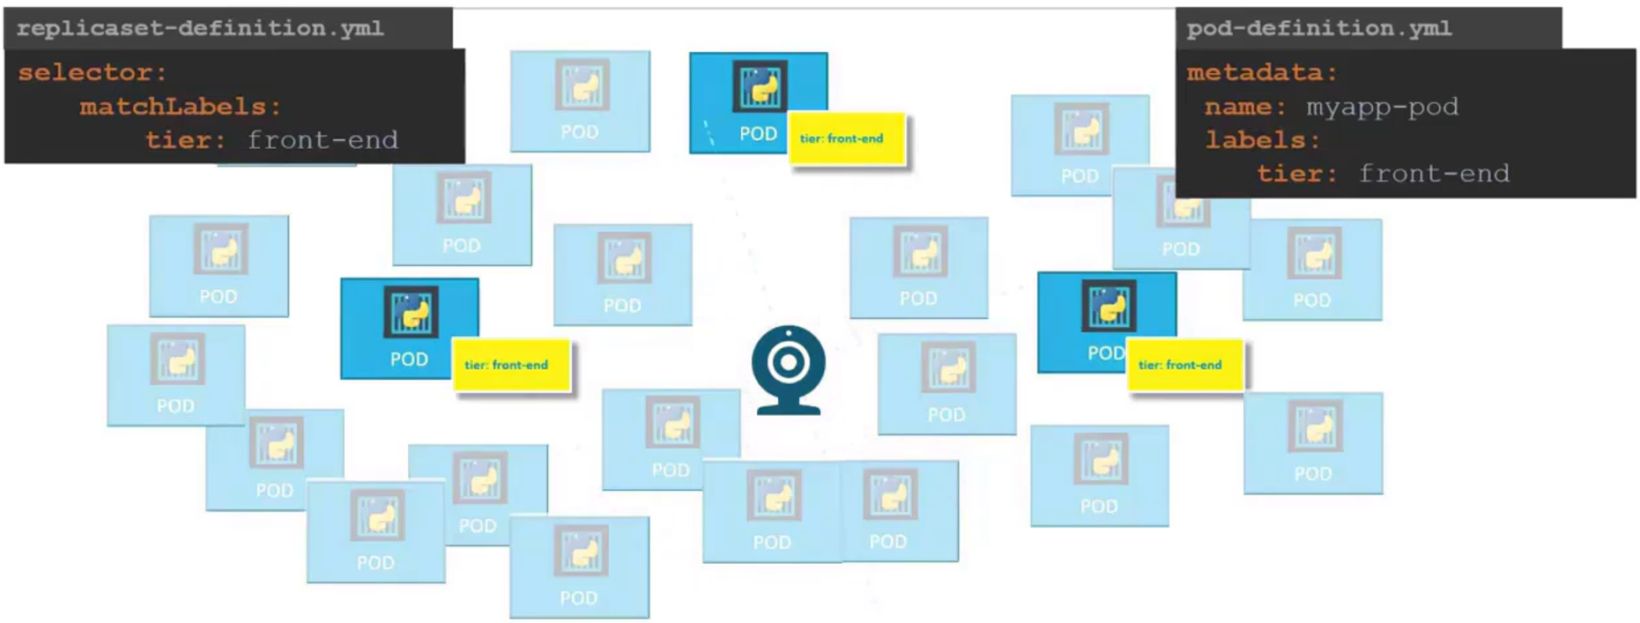
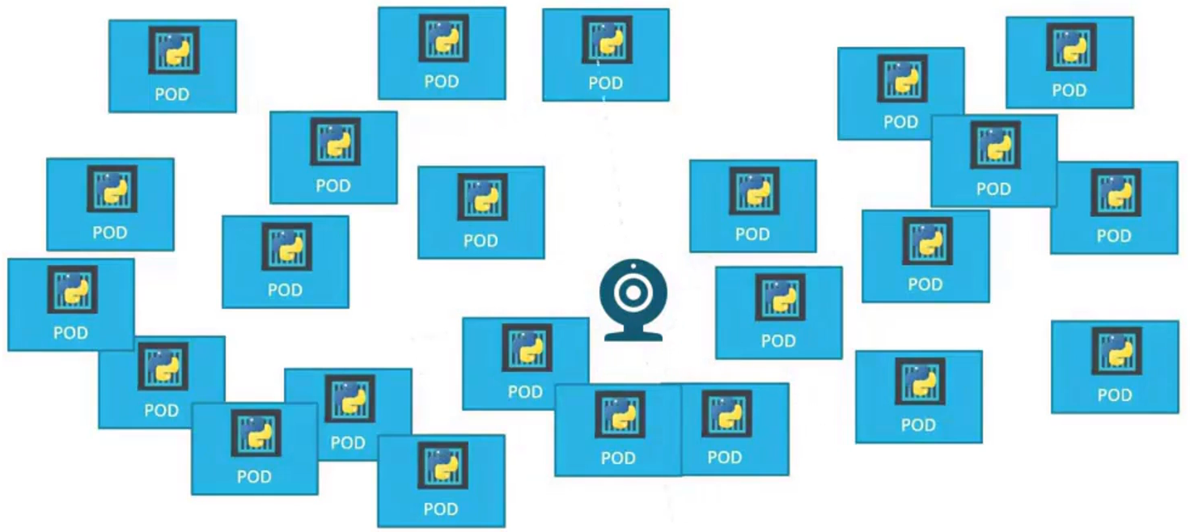
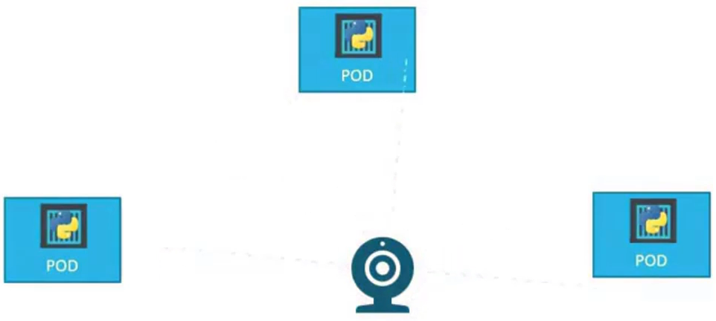

Slide 20
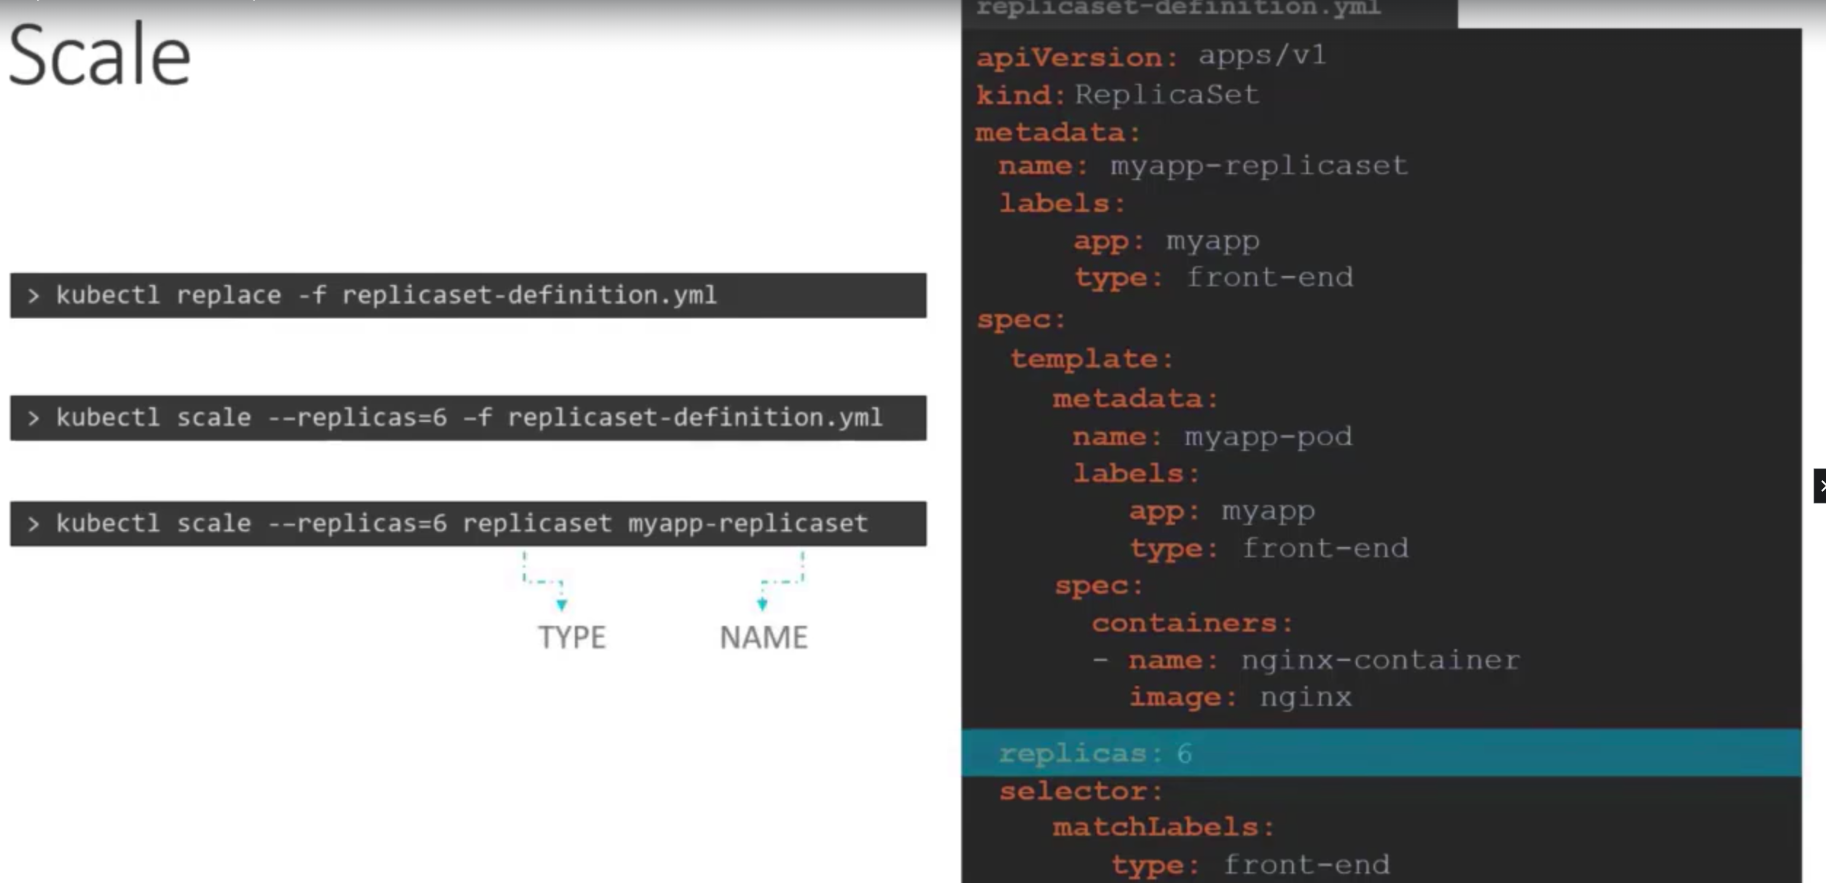

Slide 21
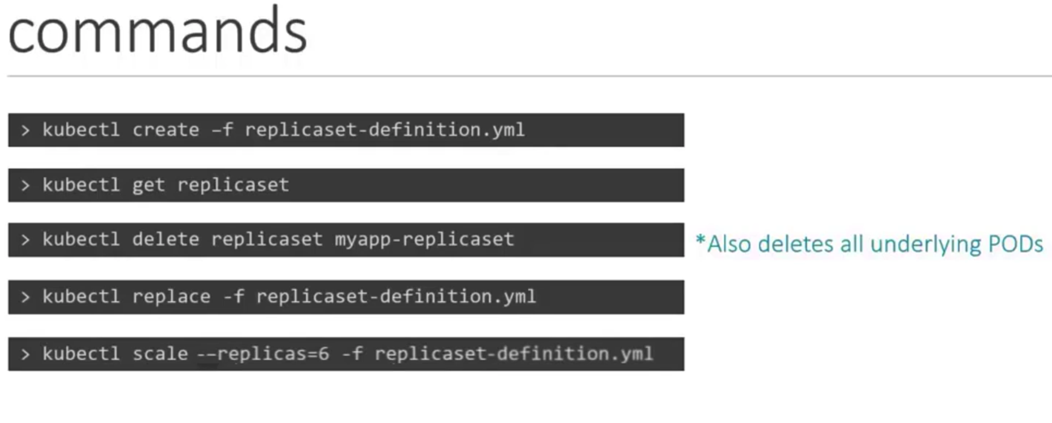

Slide 22
Replicaset Demo
Create replicaset
$ kubectl create –f replicaset.yaml
$ kubectl get replicaset
$ kubectl get pods
Let us delete and check if replicaset create a new pod
$ kubectl delete pod <pod-name>
$ kubectl describe replicaset myapp-replicaset
Let us create a new pod with the same label as in the replicaset
$ kubectl create –f pod1.yaml
$ kubectl get pods

Slide 23
Replicaset Demo
Scaling
Using kubectl edit
Using kubectl scale
Modifying yaml and applying using kubectl replace
Using kubectl edit
$ kubectl edit replicaset myapp-replicaset
$ kubectl get pods

Slide 24
Replicaset Demo
Using kubectl scale
$ kubectl scale replicaset myapp-replicaset --replicas=2
$kubectl get pods
Modifying yaml and kubectl replace
$kubectl replace –f replicaset.yaml
Deleting replicaset
$ kubectl delete replicaset myapp-replicaset

Slide 25
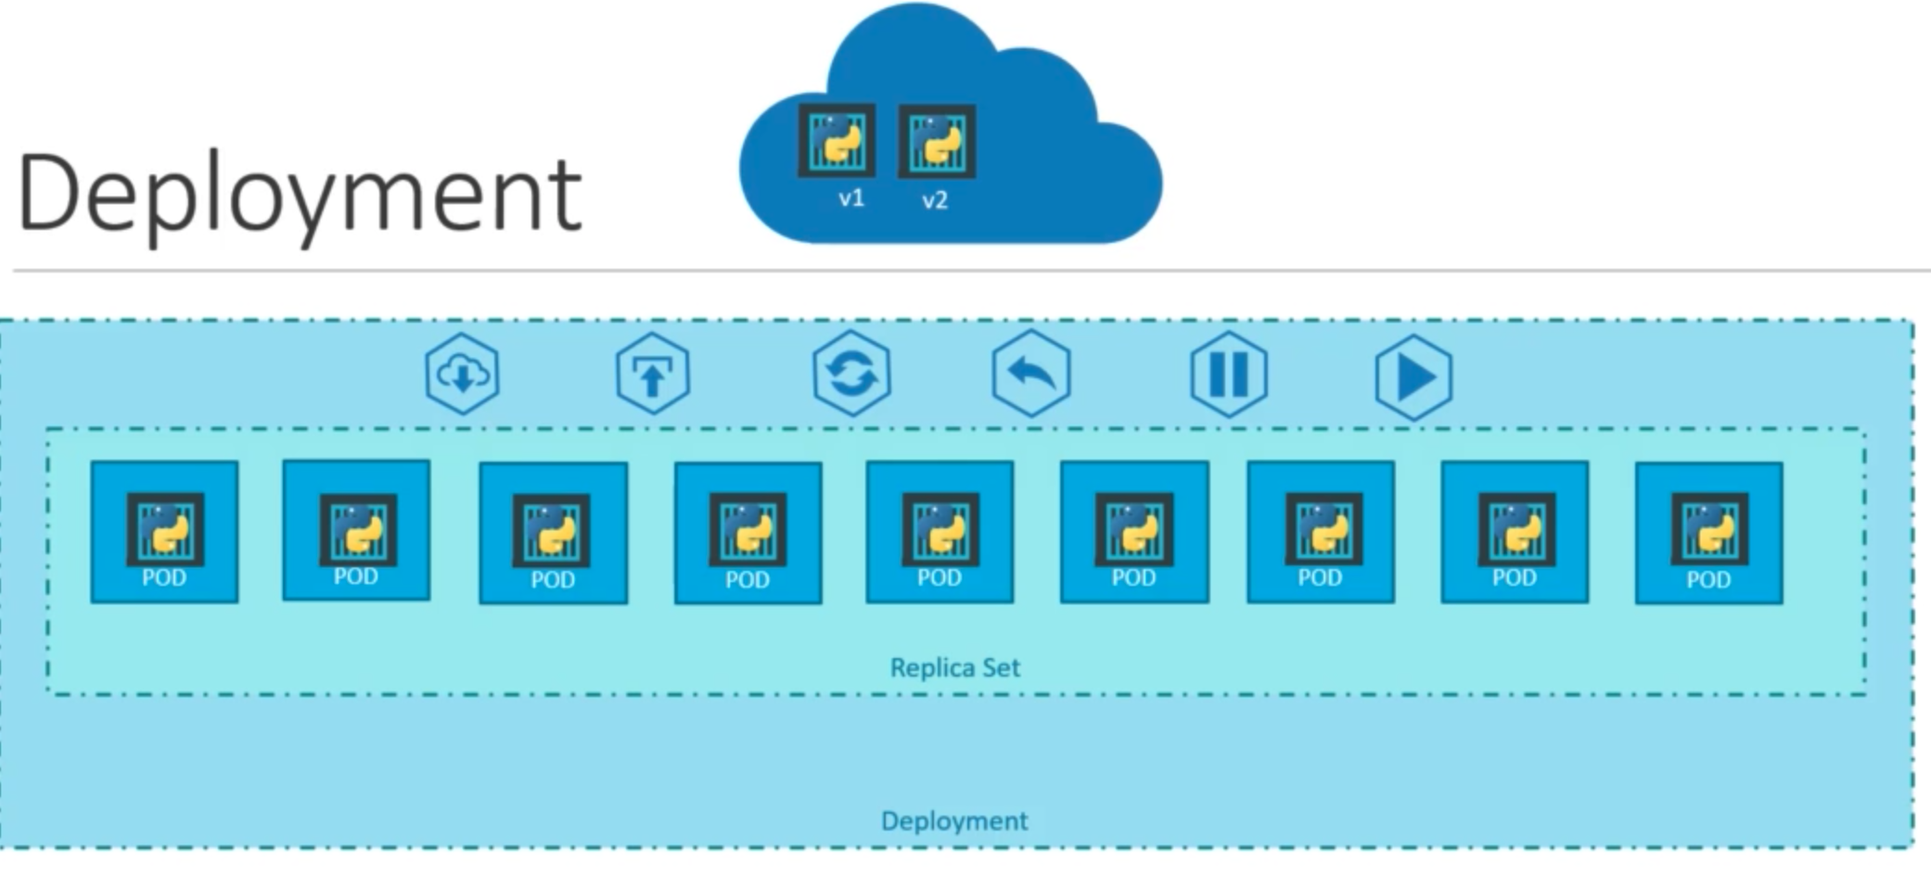
Deploy, update, rolling update, rollback, pause and resume changes

Slide 26
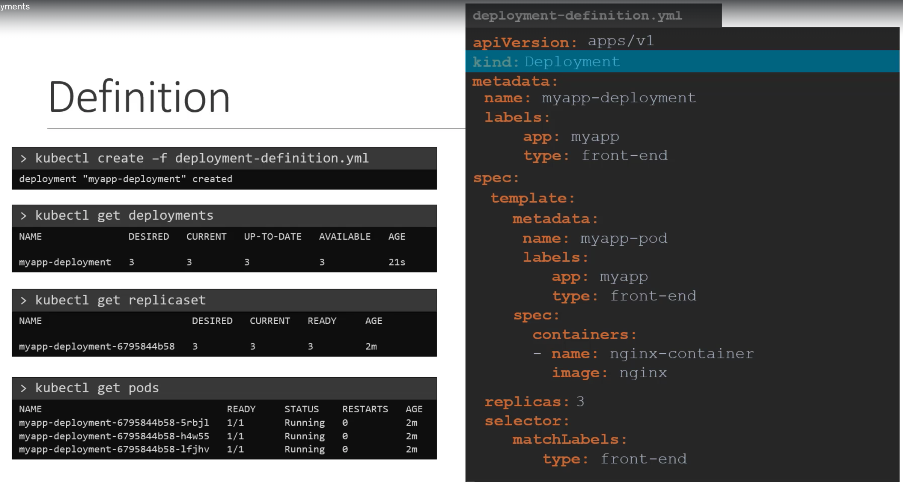

Slide 27
Deployment Demo
Create a deployment
$ kubectl create -f deployment.yaml
$ kubectl get deployments
$ kubectl get pods
$ kubectl describe deployment myapp-deployment
$kubectl get all

Slide 28
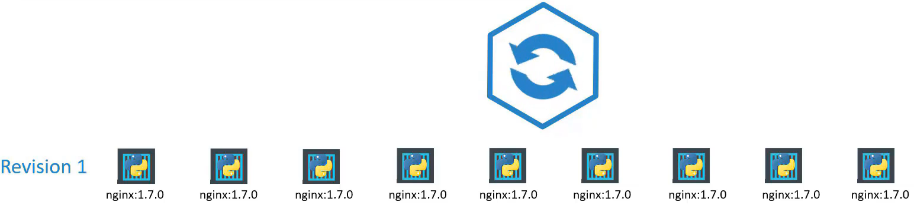
Rollout and versioning

Slide 29
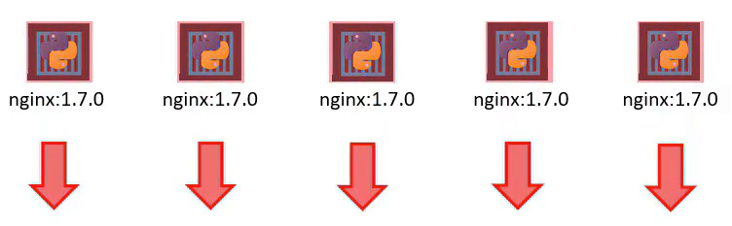
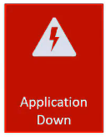
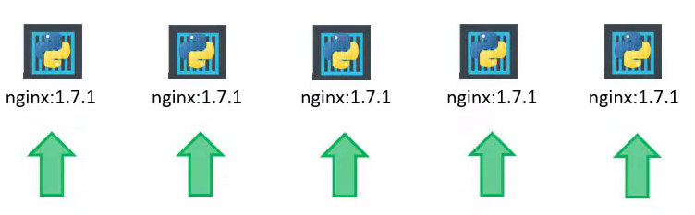
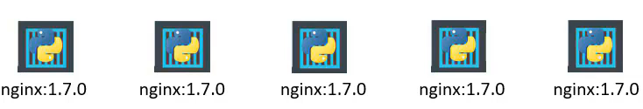
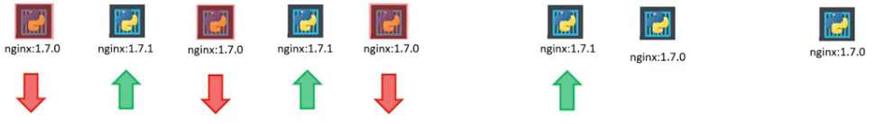
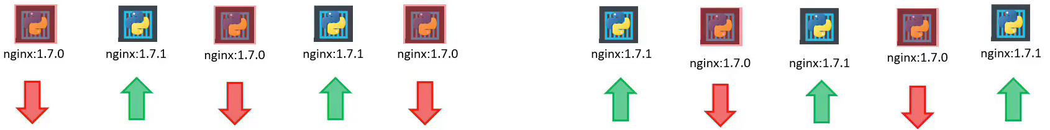
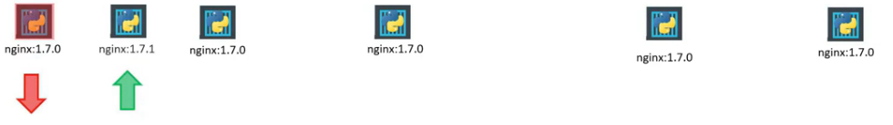
Deployment Strategy
Recreate
Rolling
update

Slide 30
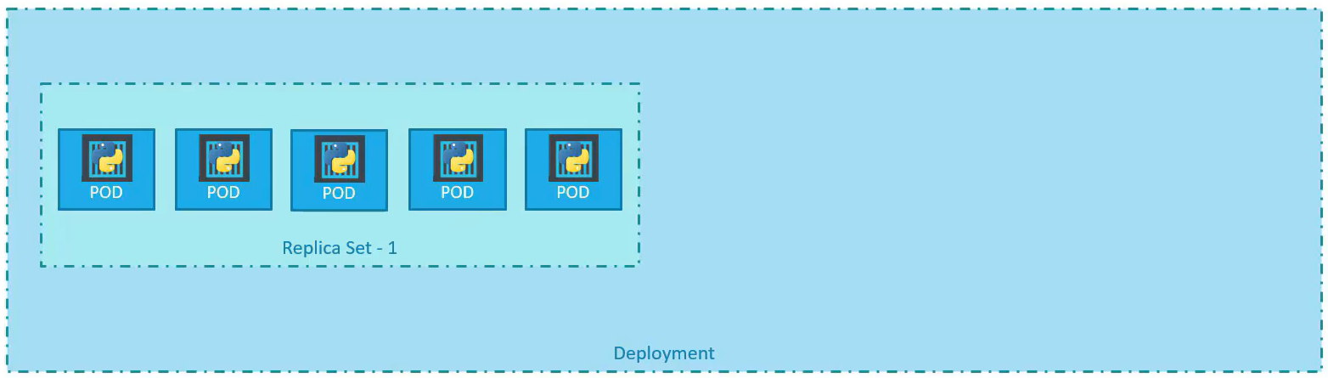

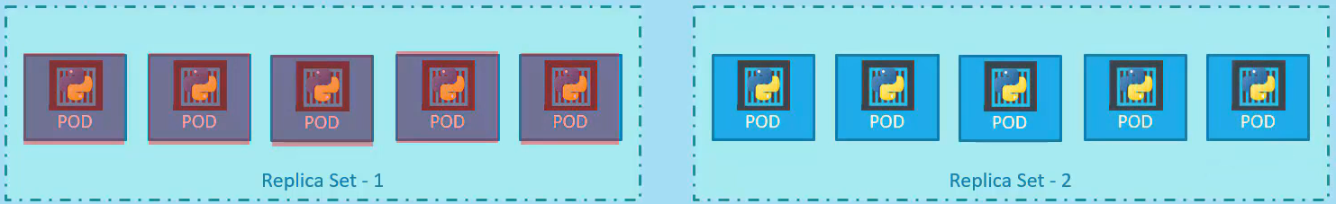
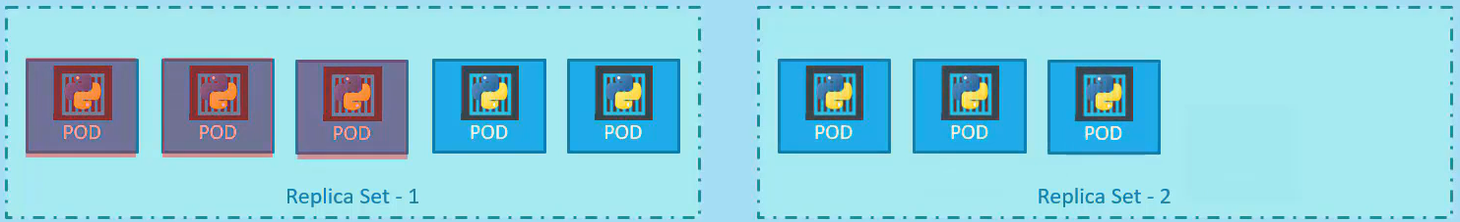
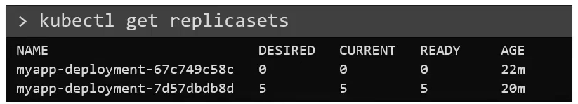
Upgrades

Slide 31
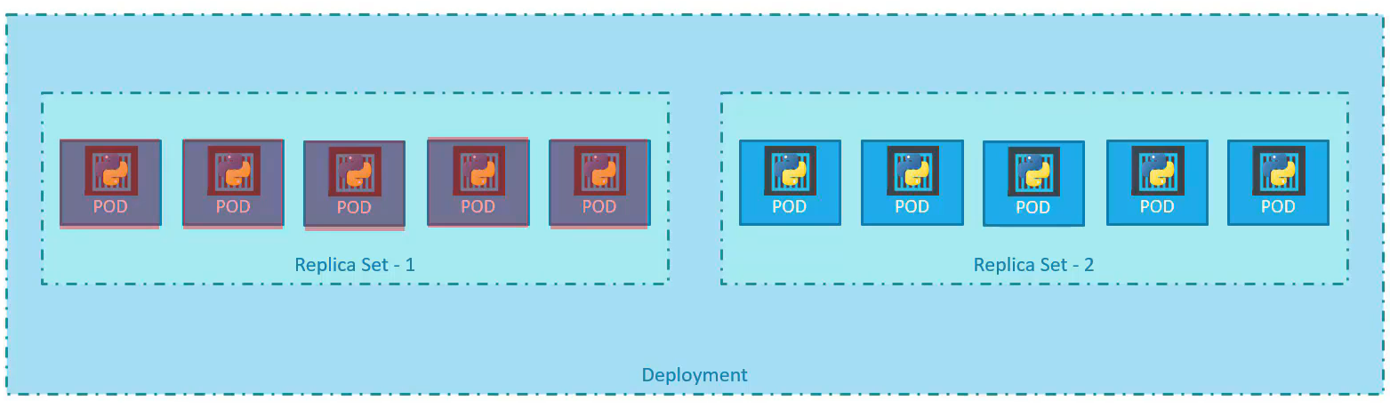
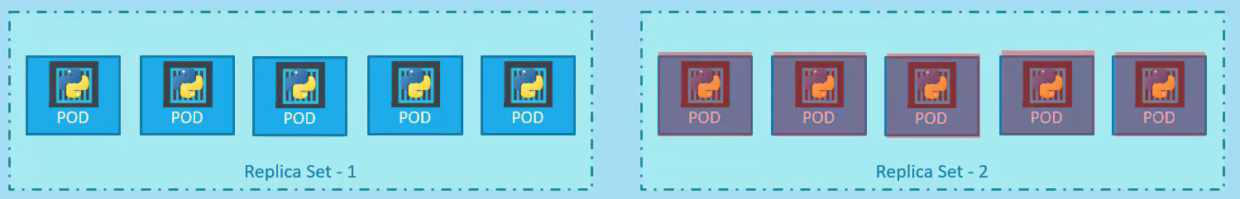
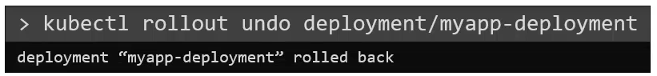
Rollback

Slide 32
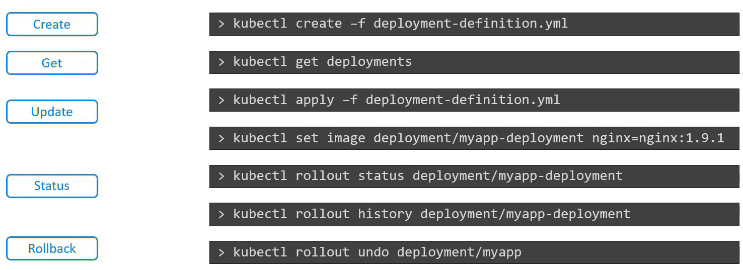
Deployment - Summary

Slide 33
Updates and Rollback Demo
Create the deployment
$ kubect create –f deployment.yaml --record
$ kubectl get deployment myapp-deployment
$ kubectl rollout status deployment.apps/myapp-deployment
$ kubectl rollout history deployment.apps/myapp-deployment

Slide 34
Update and Rollback Demo
Change the nginx image from nginx to nginx:1.18​
$ kubectl edit deployment myapp-deployment –record​
$ kubectl rollout status deployment.apps/myapp-deployment​
$ kubectl rollout history deployment.apps/myapp-deployment​
$ kubectl describe deployment myapp-deployment​
To move back to previous revision​
$ kubectl rollout undo deployment/myapp-deployment

Slide 35
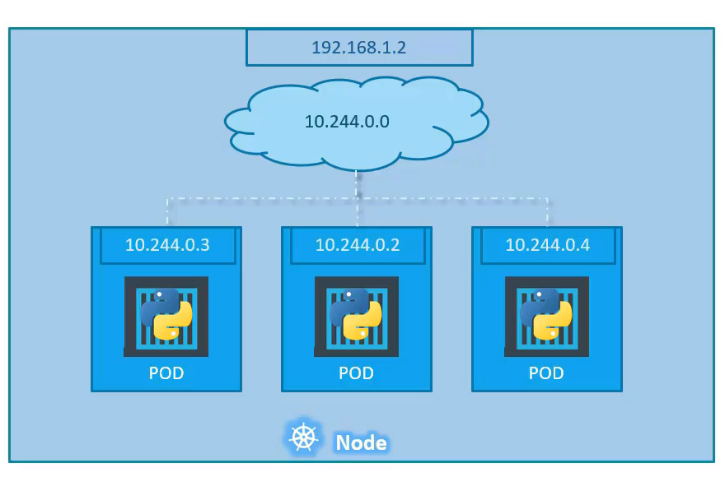
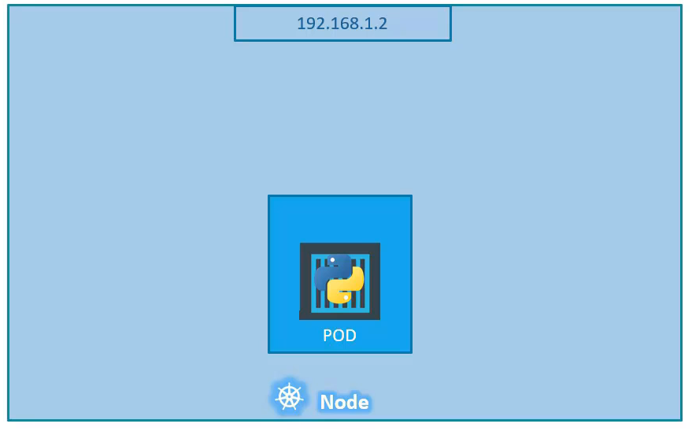
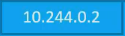
Kubernetes Networking

Slide 36
Kubernetes Networking
Kubernetes fundamental requirements on any networking implementation:
pods can communicate with all other pods on any other node without NAT
agents on a node (e.g. system daemons, kubelet) can communicate with all pods on that node

Slide 37
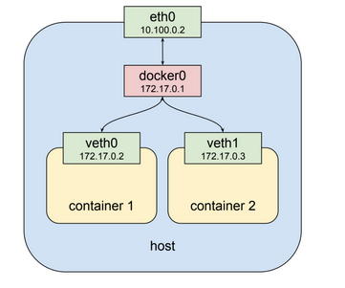
Pod-Pod Communication within a node
Each container has an ip address and communication happens between L2 bridging.
Pod1
Pod2
Ref: https://ibm.github.io/k8s-netsim

Slide 38
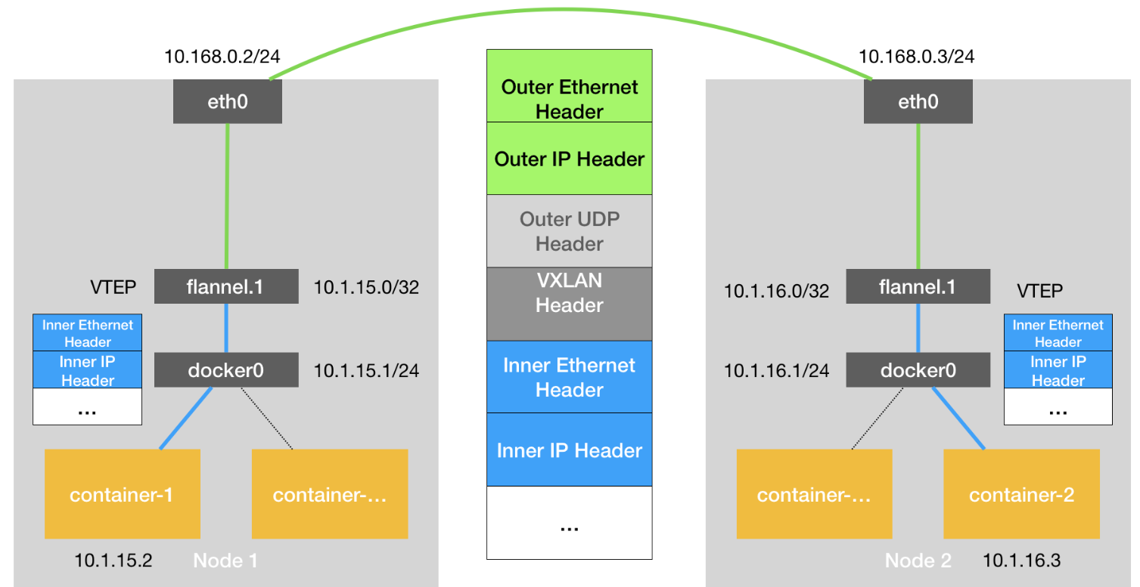
Pod-Pod communication in different nodes
Communication happens by VXLAN.
Done using CNI
Existing CNI
Flannel
Calico
Cilium
Weavenet ...
Ref: https://ibm.github.io/k8s-netsim

Slide 39
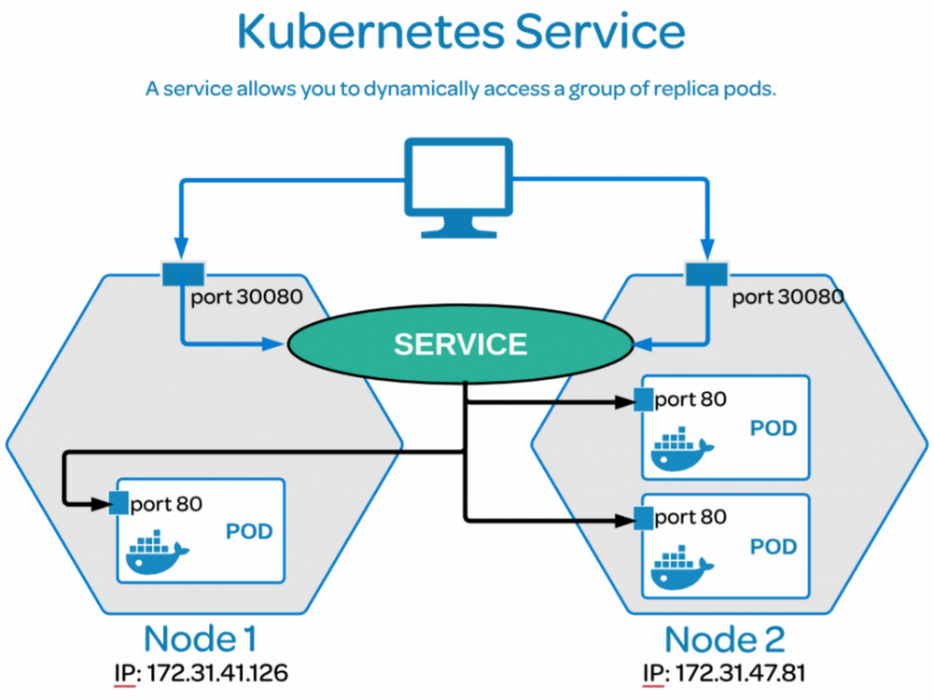
Services
Pods can get crashed and created.
Accessing a pod with IP addresses is difficult.
Service is an abstraction over the pods.
It gives a virtual IP to access the pods.
Ref: https://ibm.github.io/k8s-netsim

Slide 40
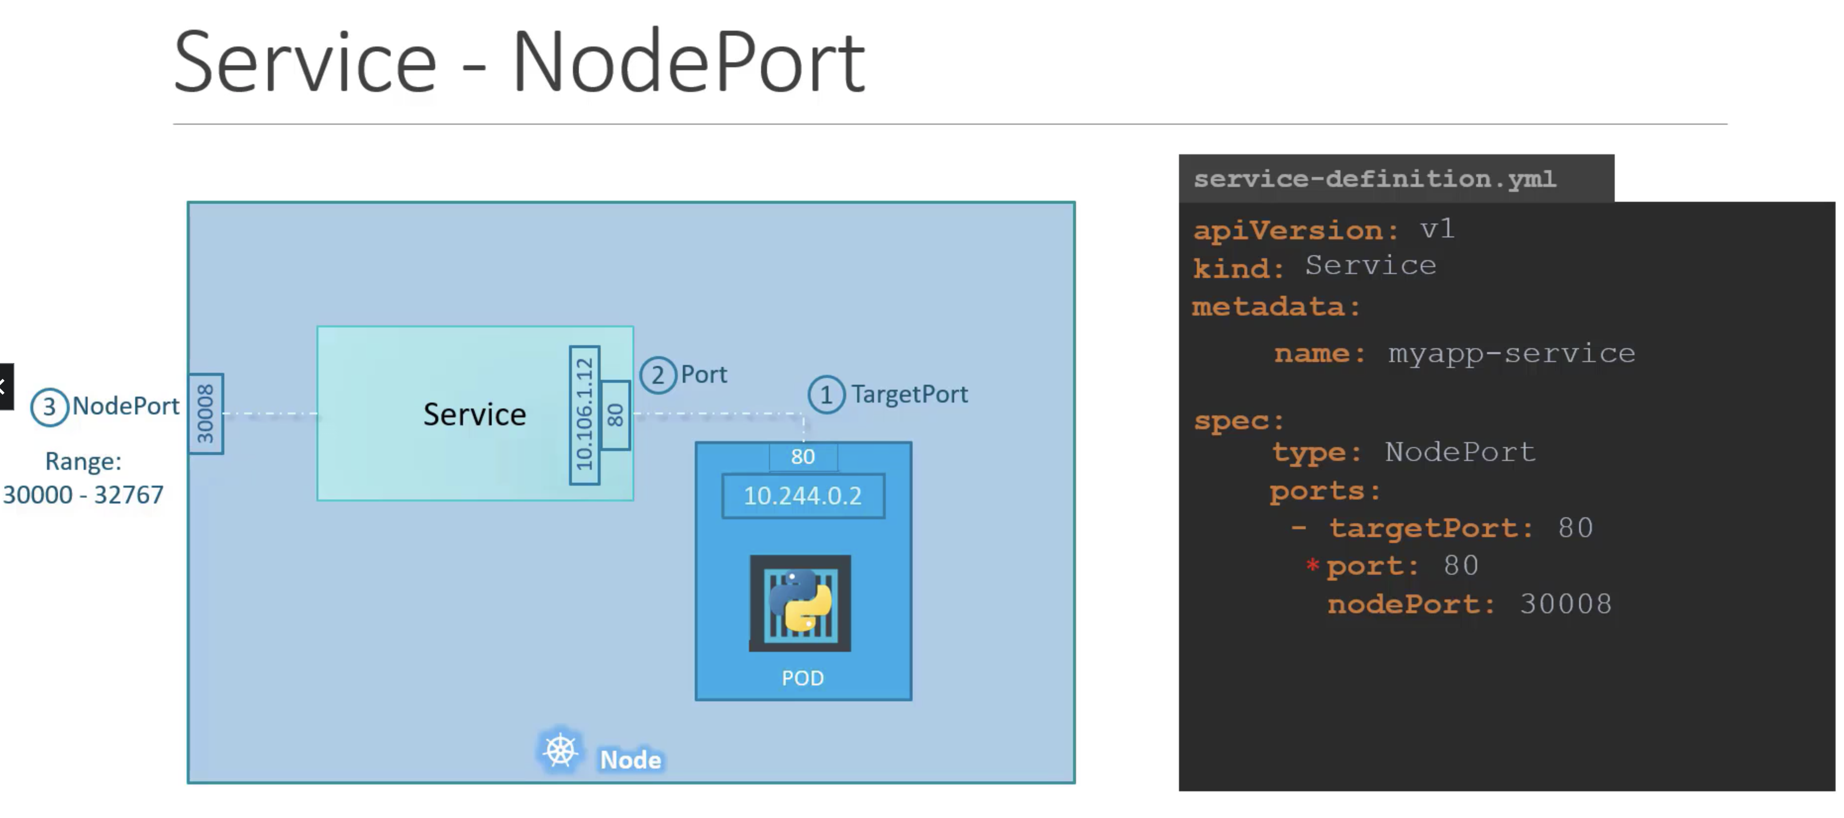

Slide 41
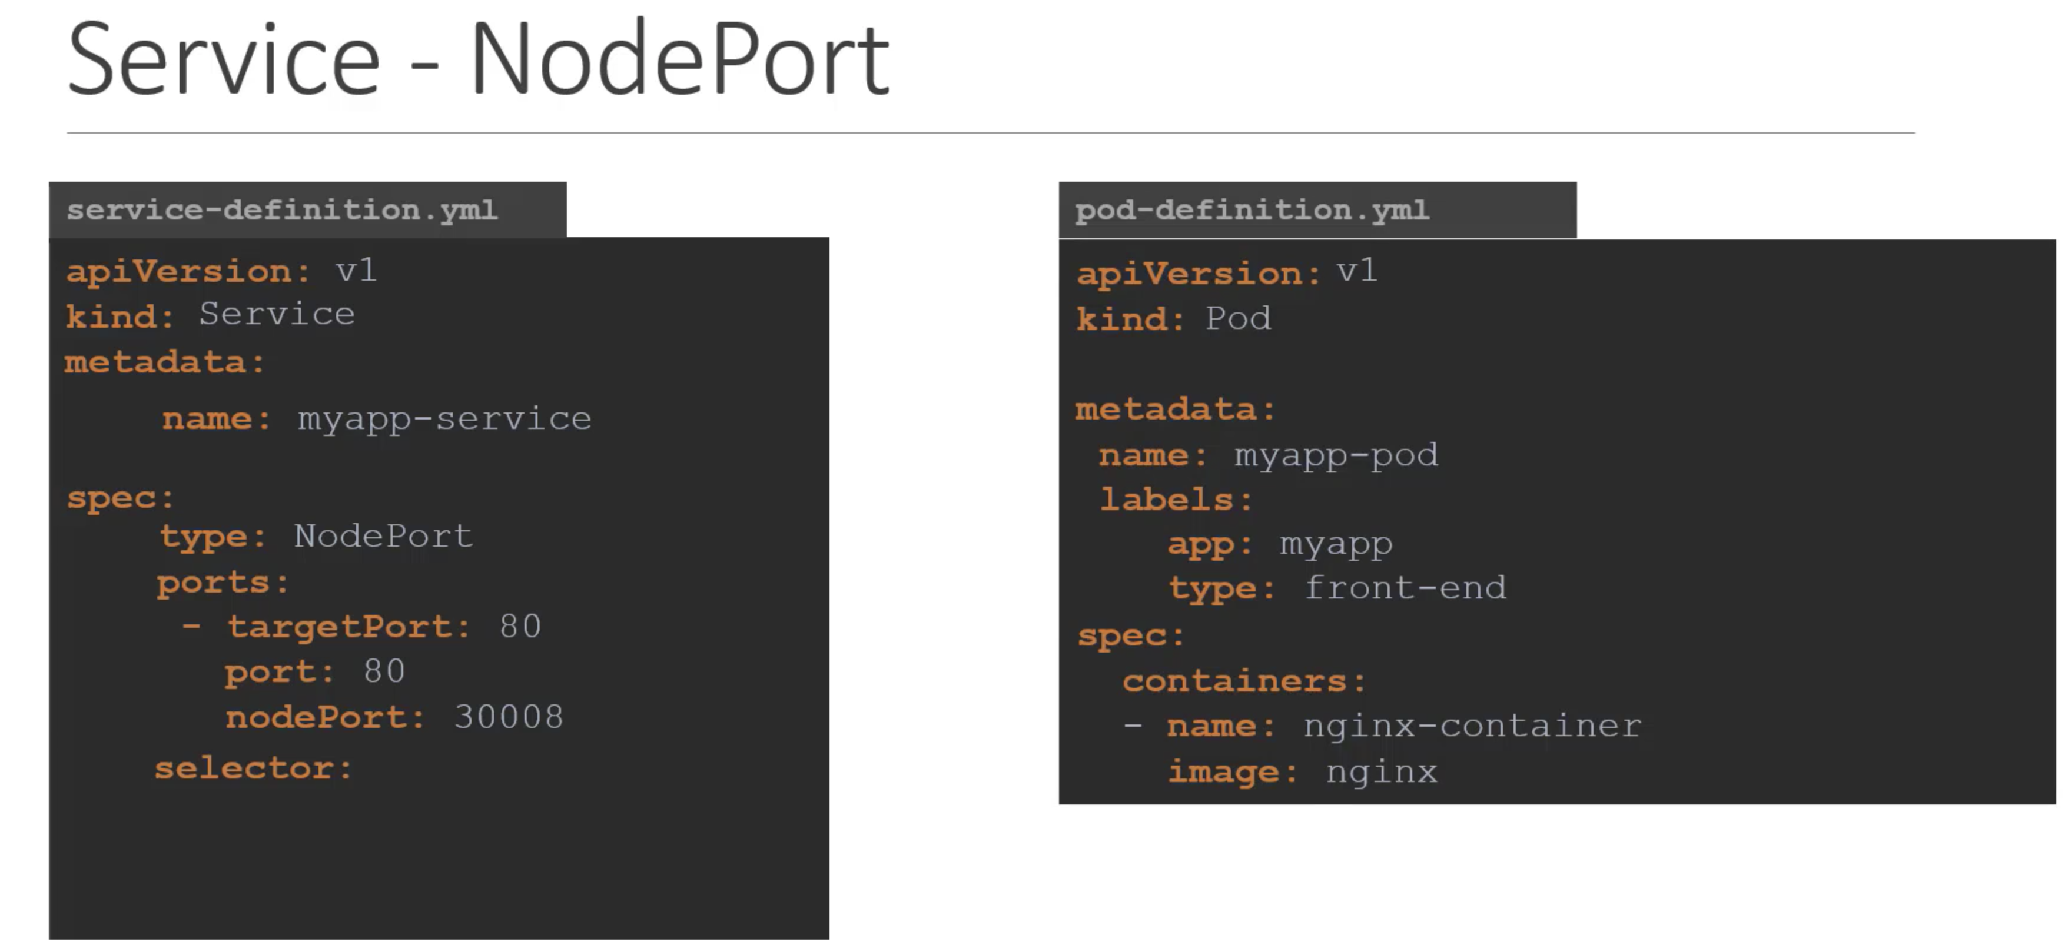
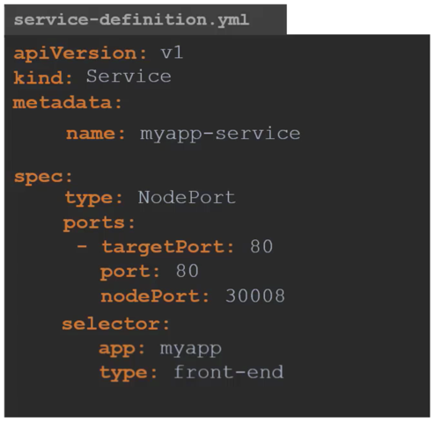

Slide 42
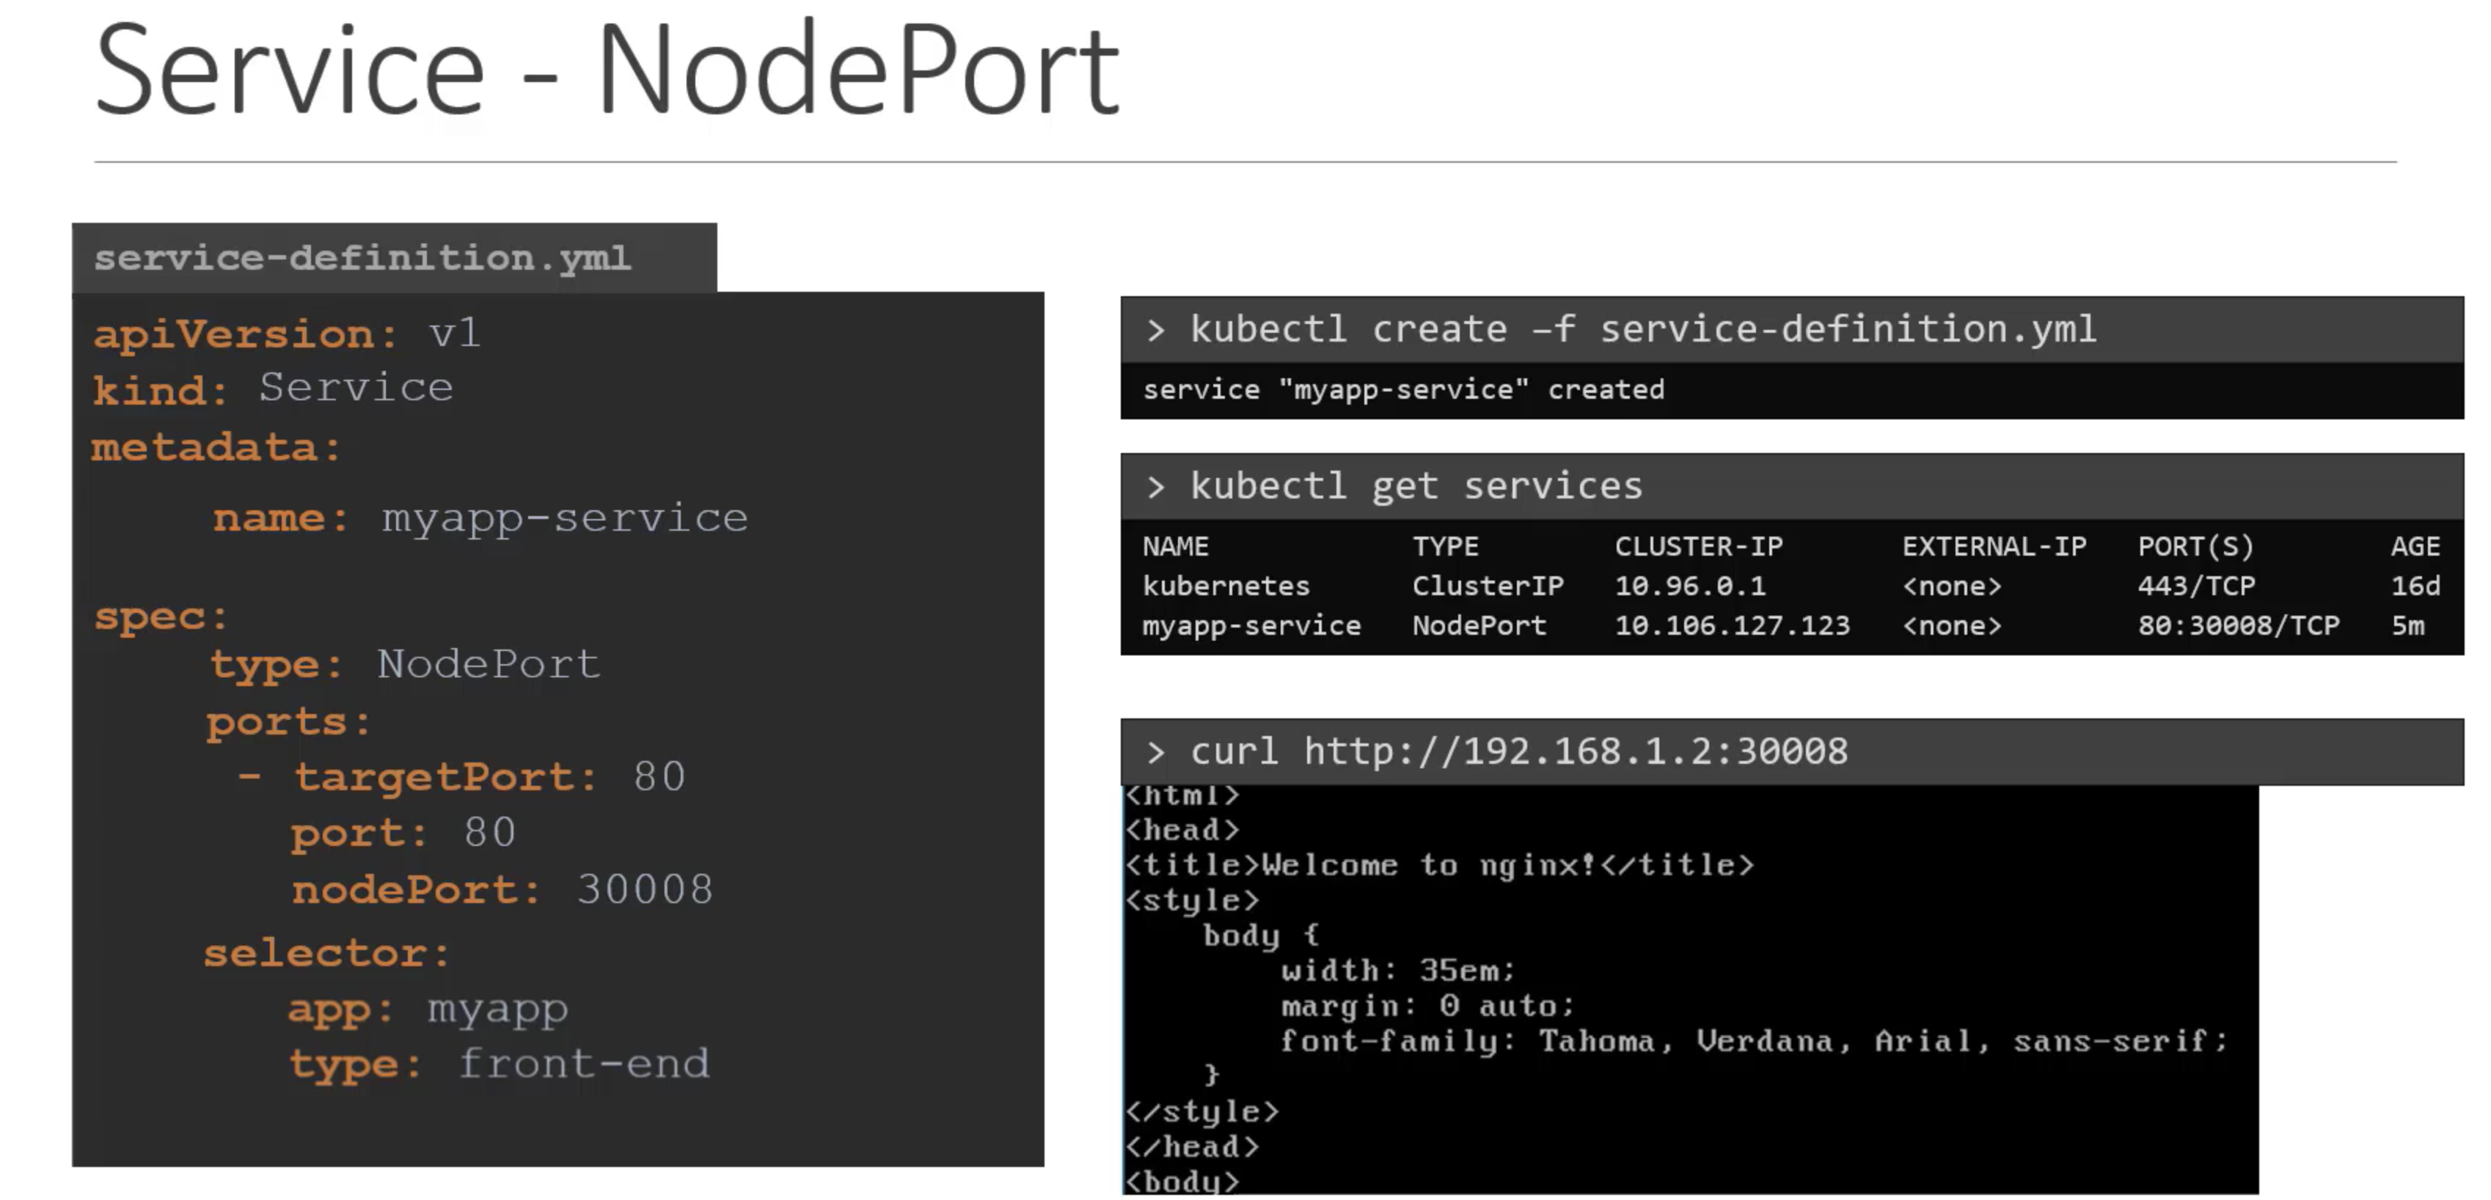

Slide 43
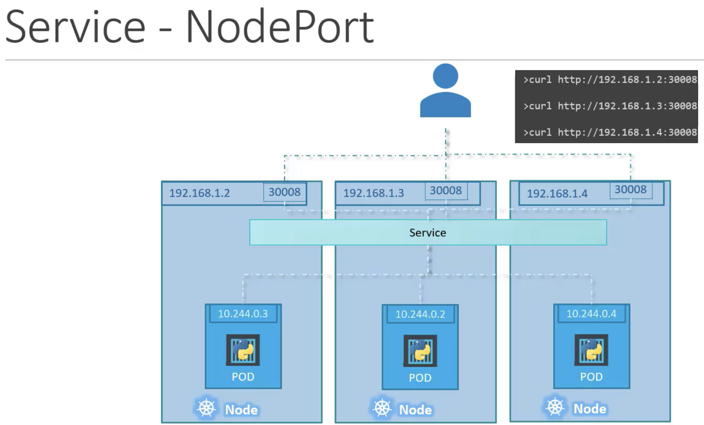

Slide 44


Slide 45




Slide 46
Thank you

